Slide 1

Comparative Evaluation of Constrained and Unconstrained Deep Reinforcement Learning for Safe Robotic Grasping on a UR5e Manipulator in Simulation
Date of defense: 08 August, 2026
Presented by,
MD ABDUR RABBI
Roll: 2031023
Supervised by,
Priyo Nath Roy
Assistant Professor
Dept. of Mechatronics Engineering
Khulna University of Engineering & Technology, Khulna

Slide 2
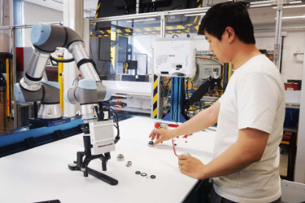
Introduction:
UR5: A collaborative arm that shares space with people
6-DOF, 5 kg payload, 850 mm reach
Max joint velocity 180 deg/s (𝜋 rad/s)
with ±360° working limit
Works next to people, not behind a fence
We use Reinforcement Learning (RL) to train robots

Slide 3
Background:
Let’s not just train a polity based on reward and penalty - start adding constraints
6-DOF, 5 kg payload, 850 mm reach
Max joint velocity 180 deg/s (𝜋 rad/s)
with ±360° working limit
Works next to people, not behind a fence
We use Reinforcement Learning (RL) to train robots

Slide 4
RESULT:
Mean Reward:
Lifting-object reward:
PPO(baseline) :
cPPO(d=25) :
cPPO(d=15) :
133.06
132.18
134.09
9.467
9.437
9.441
PPO (baseline)
cPPO (d = 25)
cPPO (d = 15)
(a) Singularity
(b) Joint limit
(c) Collision
0.08
0.4
0.0006
0.06
0.3
Cost contribution
0.04
0.0004
0.2
0.1
0.02
0.0002
0.0
0.00
0.0000
0
500
1000
1500
0
500
1000
1500
0
500
1000
Training iteration
Training iteration
Training iteration

Slide 5
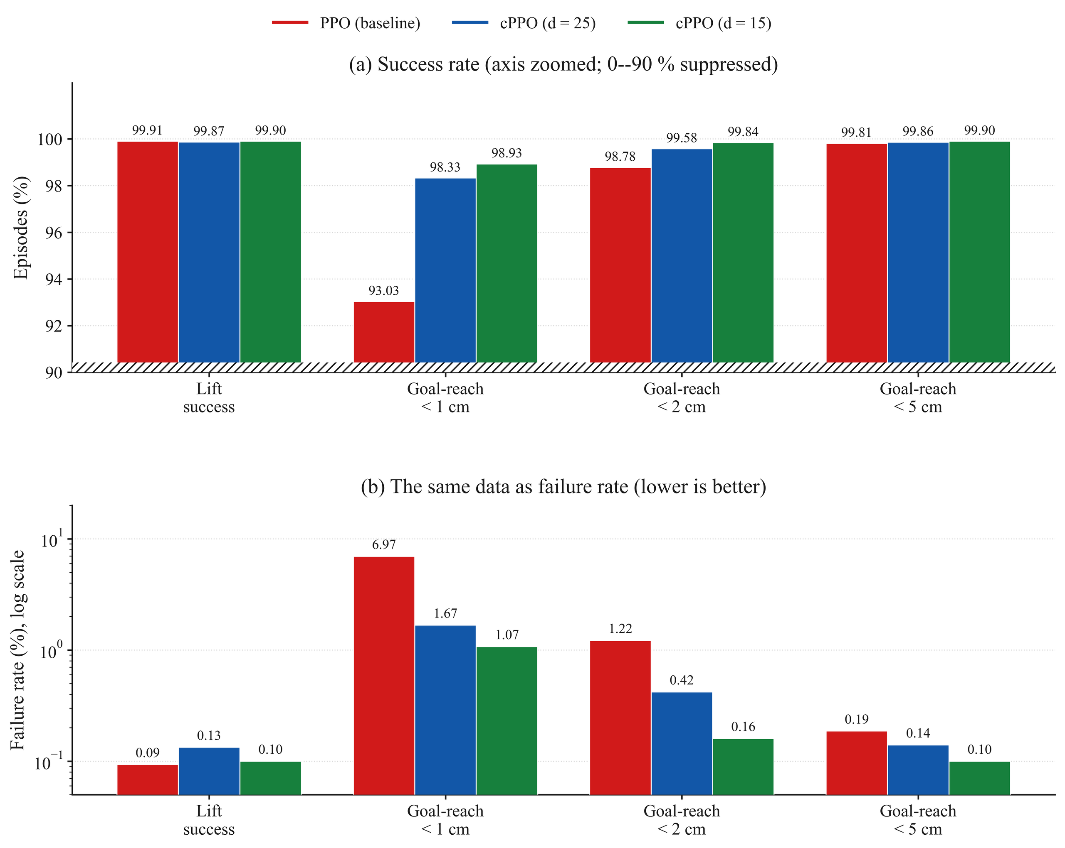
RESULT:
The constraint costs nothing measurable
Constraining the policy did not cost task performance at either budget.
*Tail mean(last 10% of the training data)

Slide 6
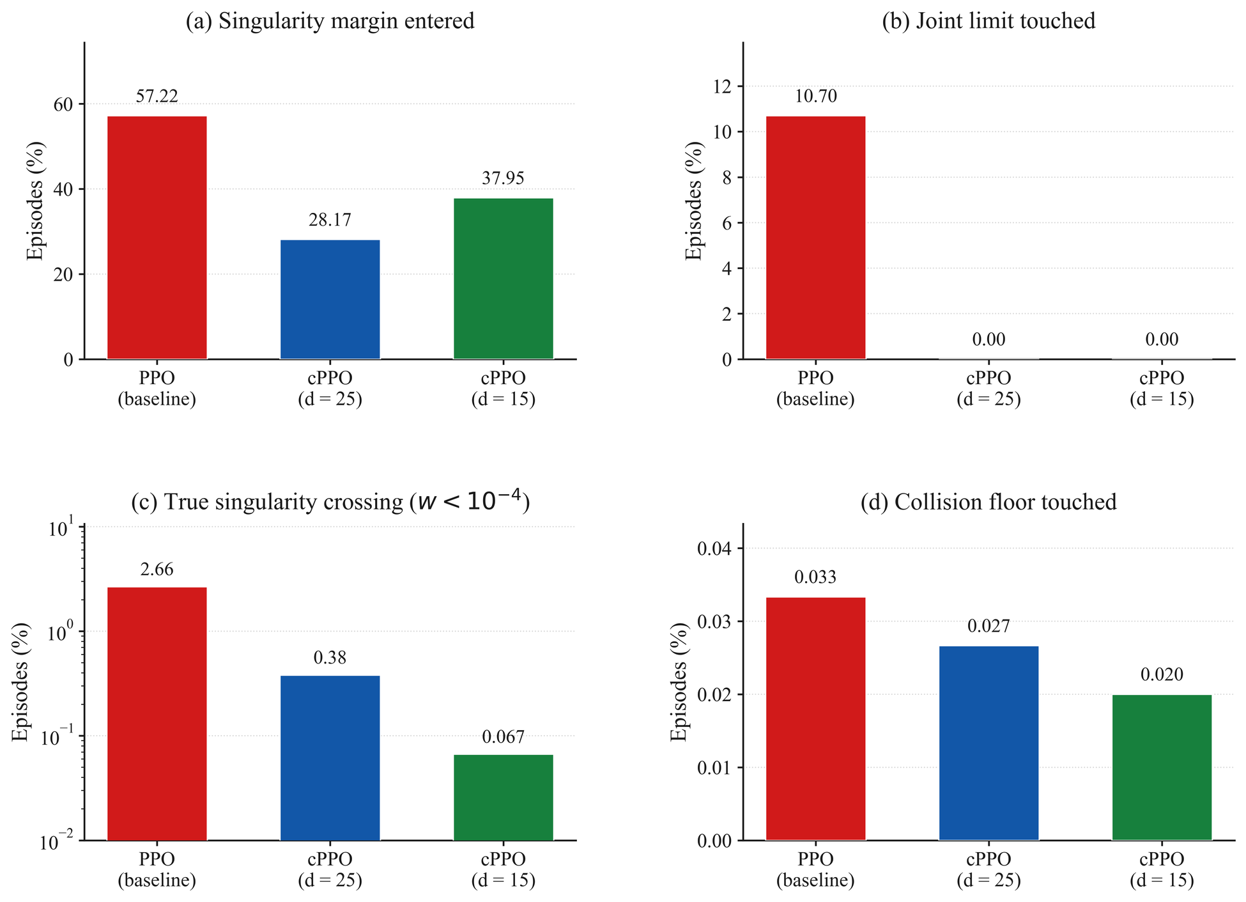
RESULT:
Safety: fewer true singularities, zero joint-limit contact

Slide 7
Conclusion:
A stated budget changes what a policy does — mostly by making it predictable

Slide 8
Key Resources:
[1] Altman, E. (1999). Constrained Markov Decision Processes. Chapman & Hall/CRC.
[2] Schulman, J. et al. (2017). Proximal Policy Optimization Algorithms. arXiv:1707.06347.
[3] Achiam, J. et al. (2017). Constrained Policy Optimization. Proc. ICML, PMLR 70.
[4] Ray, A., Achiam, J., & Amodei, D. (2019). Benchmarking Safe Exploration in Deep RL. OpenAI.
[5] Stooke, A., Achiam, J., & Abbeel, P. (2020). Responsive Safety in RL by PID Lagrangian Methods. Proc. ICML, PMLR 119.
[6] Yoshikawa, T. (1985). Manipulability of Robotic Mechanisms. Int. J. Robotics Research, 4(2).
[7] Henderson, P. et al. (2018). Deep Reinforcement Learning That Matters. Proc. AAAI 32(1).
[8] Khan, F. et al. (2026). RL for Precision Grasping and Safety-Critical Coordination in a Robotic Arm. Intelligent Service Robotics, 19(16).
[9] Shen, Y. et al. (2022). RL-Based Reactive Obstacle Avoidance for Redundant Manipulators. Entropy, 24(2).

Slide 9
Key Resources:
[10] Xia, W. et al. (2024). Deep RL Based Proactive Dynamic Obstacle Avoidance for Safe Human-Robot Collaboration. Manufacturing Letters, 41.
[11] Ferreira, H. C. & Barbosa, R. S. (2025). Deep RL for Adaptive Robotic Grasping in Simulated Dynamic Environments. Future Internet, 17(10).
[12] Shahid, A. A. et al. (2022). Continuous Control Actions Learning and Adaptation for Robotic Manipulation through RL. Autonomous Robots, 46.
[13] Mittal, M. et al. (2023). Orbit: A Unified Simulation Framework for Interactive Robot Learning Environments. IEEE RA-L, 8(6).
[14] Rudin, N. et al. (2022). Learning to Walk in Minutes Using Massively Parallel Deep RL. Proc. CoRL, PMLR
[15] Universal Robots A/S (2023). UR5e Technical Specifications. Product datasheet.
[16] Khan, M. M. (2025). Enhancing Manipulator Control Through IBVS Techniques Using ROS2. BSc thesis, KUET.

Slide 10
THANK YOU

